Slide 1
LLMA: LLM-Assisted Formal Verification Framework for Process Control Software Evolution
Notes:
Today I’ll present our work Antarbhukti (“Containment”) — a formal approach to verify PLC software correctness during evolutionary upgrades.
It tackles a key challenge in industrial automation: ensuring upgrades don’t break previously correct behavior. I’ll cover the motivation, our Petri net–based containment framework, symbolic equivalence algorithm, results on 80 real-world PLC programs, Industrial use case and open research directions.

Slide 2

PLC Upgrade Challenges
Industrial PLC systems evolve frequently
Manual regression testing is slow
Need formal assurance without full re-testing
Notes:
Industrial PLC systems — running assembly lines or robotic arms — keep evolving with new sensors, safety checks, and updates. But every upgrade risks breaking earlier correct behavior, leading to costly downtime or safety issues. Traditional regression testing is manual and incomplete. So, we ask a formal question: Does the new PLC version preserve all behaviors of the old one? If yes, the upgrade can be certified with confidence.

Slide 3
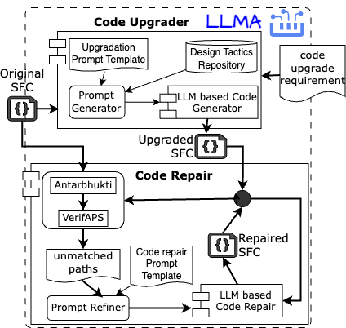
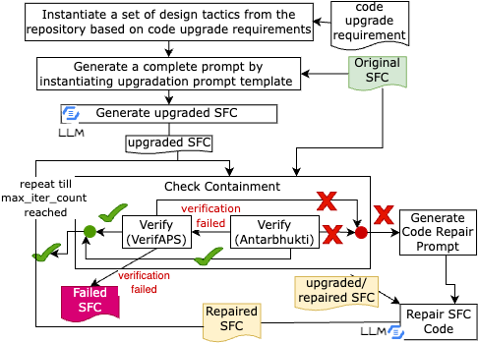
Work Flow

Slide 4
Design Tactics Table
QUALITY | TACTIC | TACTIC IMPLEMENTATION STRATEGY
⚙️ Reliability | Input Validation | When: Input out of range. Action: Add ValidateInput → ValidationError.
 | Execution Bound | When: Loop exceeds limit. Action: Use counter → SafeAbort.
 | Intermediate Logging | When: After critical steps. Action: Insert Log step.
 | Watchdog | When: Abnormal variable. Action: WatchdogCheck → WatchdogError.
🛡️ Safety | Emergency Stop | When: Unsafe conditions. Action: EmergencyStopCheck → fail-safe mode.
 | Input Validation | When: Unsafe input. Action: SafetyCheckInput → SafetyError.
 | SafeState Logging | When: Safety transitions. Action: Insert SafetyLog.
 | Timeout | When: Over time/cycles. Action: TimeoutSafeStop → halt & flag.

Slide 5
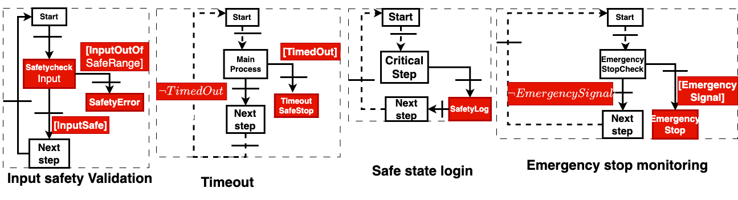
Safety upgradation using LLM

Slide 6
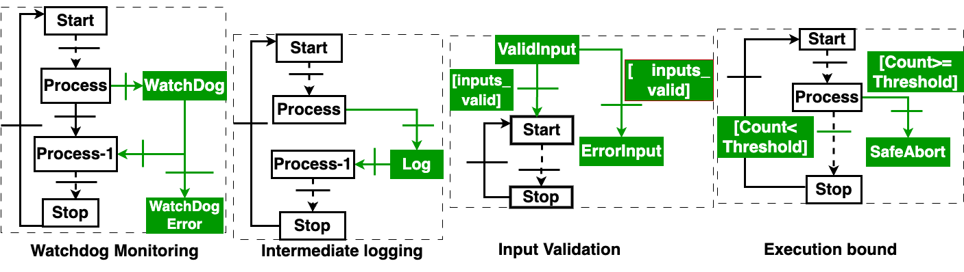
Reliability upgradation using LLM

Slide 7
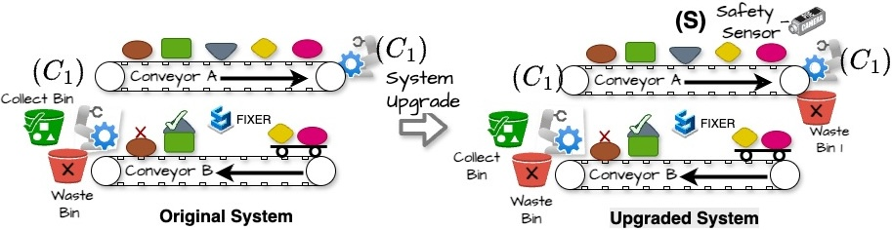
Motivating Example (A pick-and-place robot controller)
The original PLC logic is straightforward: move arm → detect object → grip → place.
In the upgraded version, a quality-check condition is inserted before the grip.
The classical testing method is not useful for two reasons.
An SFC software testing generally takes 3 to 5 minutes by an expert engineer in a testing environment.
The older version is purely sequential, whereas the upgraded version has parallelism, as it performs the scaling computation concurrently.
ORIGINAL
Automated robotic arm transfers items from Conveyor A to Conveyor B.
Conveyor B uses a scaling sensor to verify parameters whether to deposit it in the Green Bin or Discard it in the Red bin
UPGRADED
A safety guard sensor per ISO 10218-1 standards.
When the safety guard is in place, the robot proceeds with item transfer and scaling checks.
Computes scaling factor adjustments concurrently for increased efficiency.
Notes:
To make this more concrete — consider an automotive plant where a PLC controls a robotic assembly step. An upgrade introduces a new emergency-check branch. Everything compiles, simulations pass, but in a rare interleaving, a valid sequence from the old logic becomes unreachable. Engineers won't notice unless they test that exact path — and they often missed out. This is exactly the kind of silent regression we are targeting.
So rather than just test the new version, we compare it behaviorally with the previous version — formally, at the model level.

Slide 8
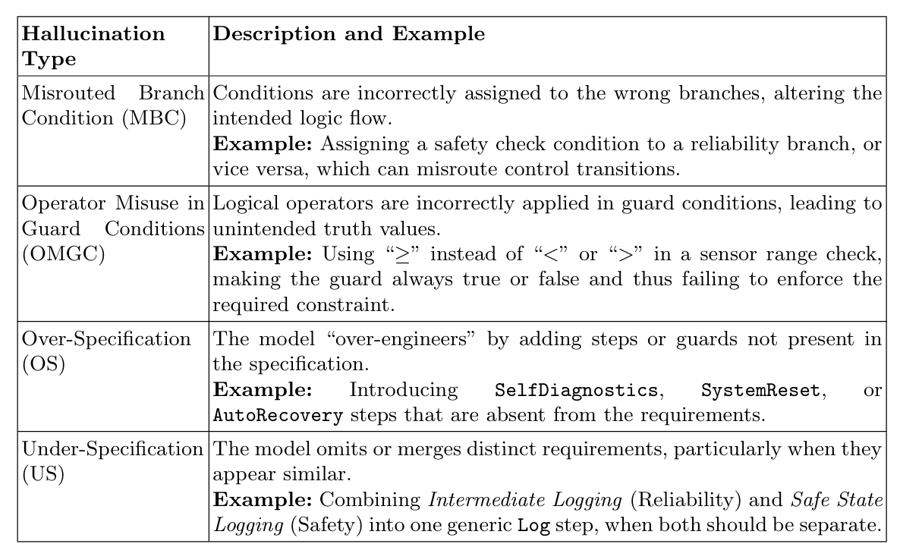
Tyes of Hallucination

Slide 9
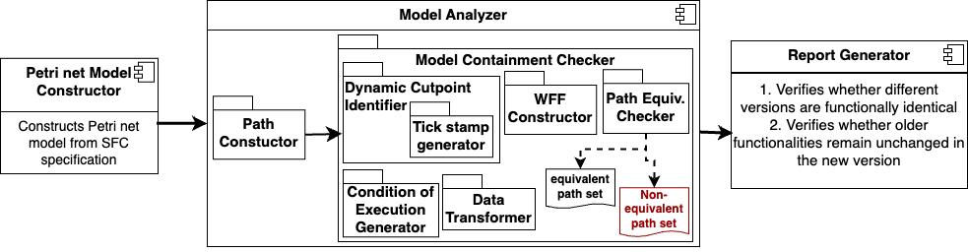
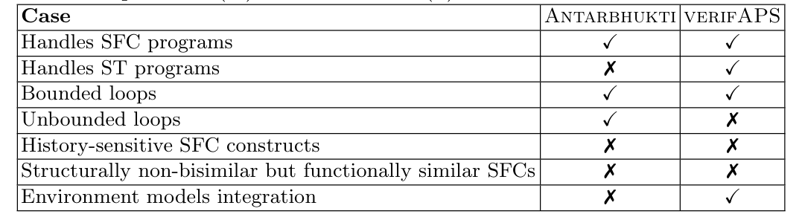
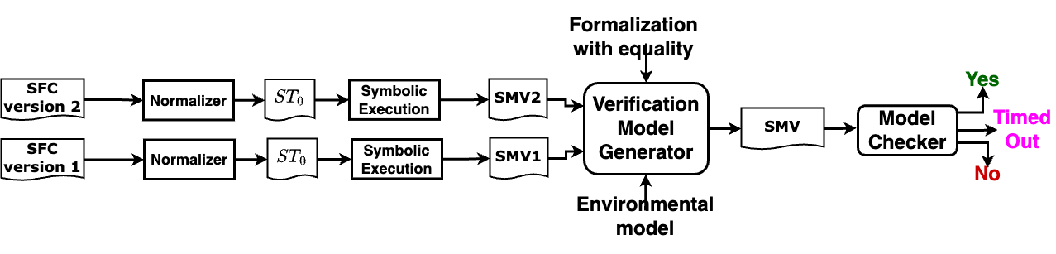
Formal Verifier
ATVA 2025 — Formal Verification
Notes:
Our approach begins by translating both the original and upgraded PLC programs into Petri nets.
Specifically, we operate on the SFC — Sequential Function Chart — representation, which is a common high-level model used in industrial PLC programming.
The intuition here is that Petri nets give us a clean mathematical semantics of concurrency, synchronization, and token flow — all of which are essential to reason about PLC execution correctly.
This is one of the key differences from prior works like verifAPS — and a major reason why we achieve faster and more accurate containment checking.

Slide 10
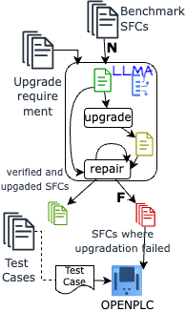
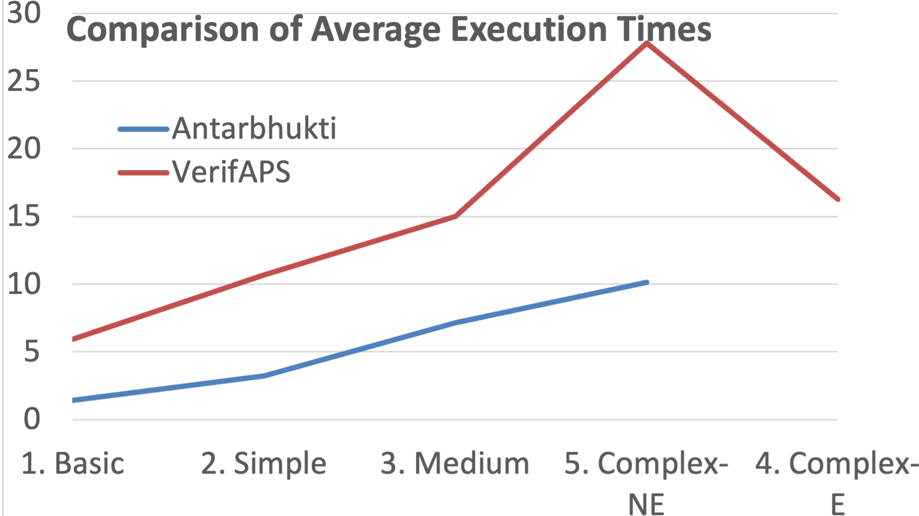
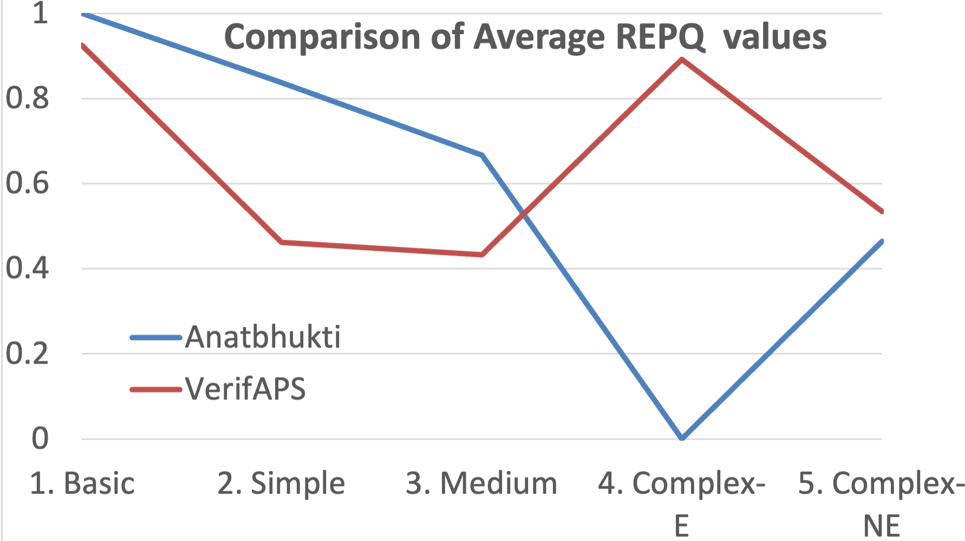
Experimental Results
Notes:
We evaluated our approach using the publicly available OSCAT Automation Library, which includes over 80 real PLC programs from domains like safety checks, counters, and motion control. For each program, we created both correct and faulty upgrade scenarios to test our checker on true positives and true negatives.
This slide compares our tool, Antarbhukti, with verifAPS, a state-of-the-art PLC verifier. In most cases, Antarbhukti performs containment checking up to 4× faster, especially in programs with higher concurrency. While verifAPS often times out, Antarbhukti finishes within 3–4 seconds, demonstrating practical scalability.

Slide 11
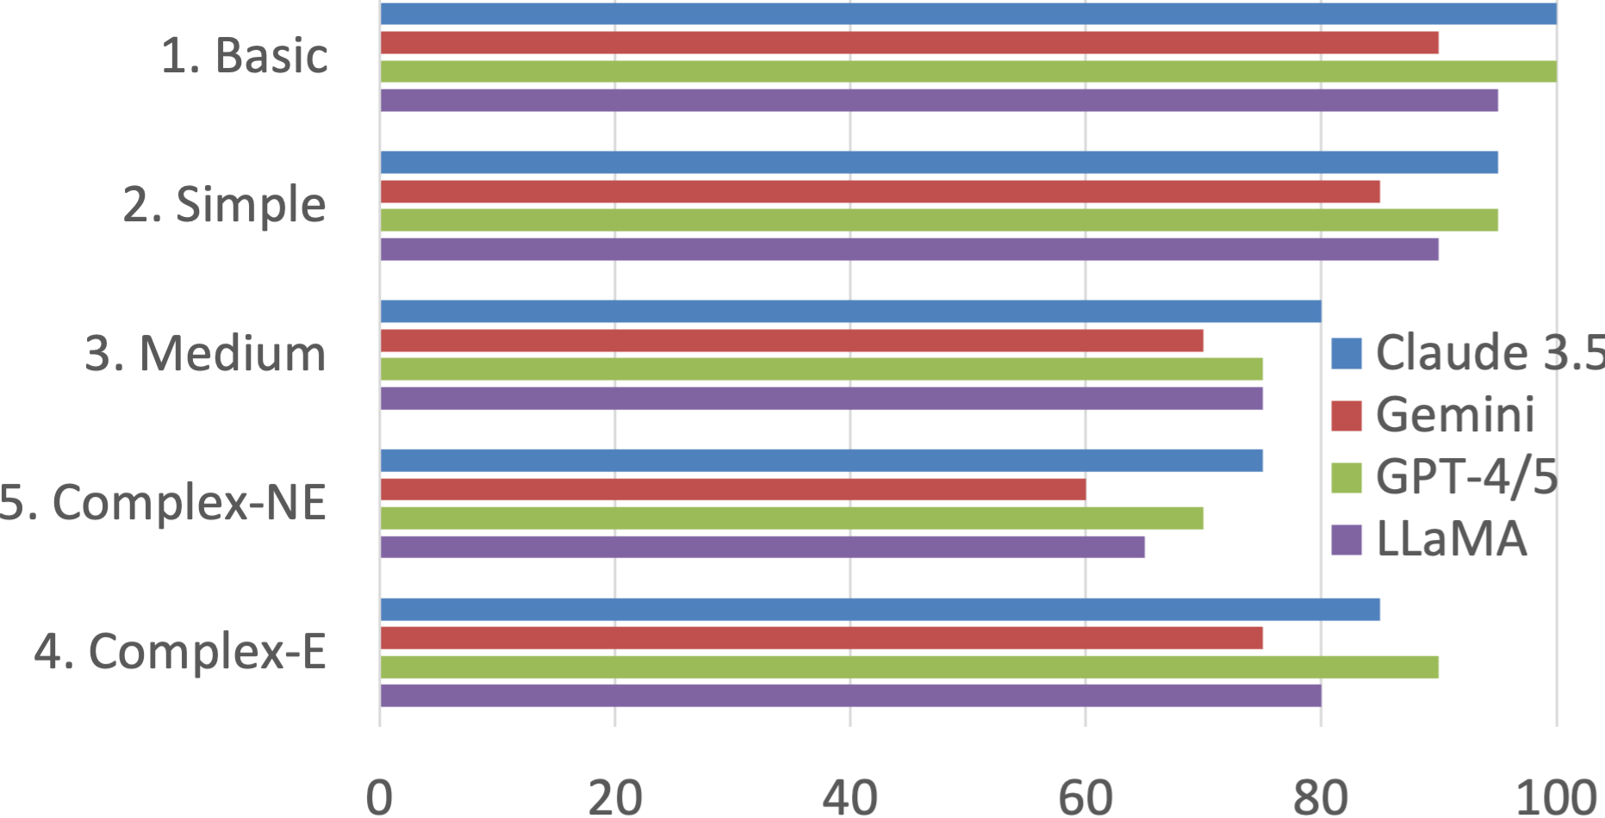
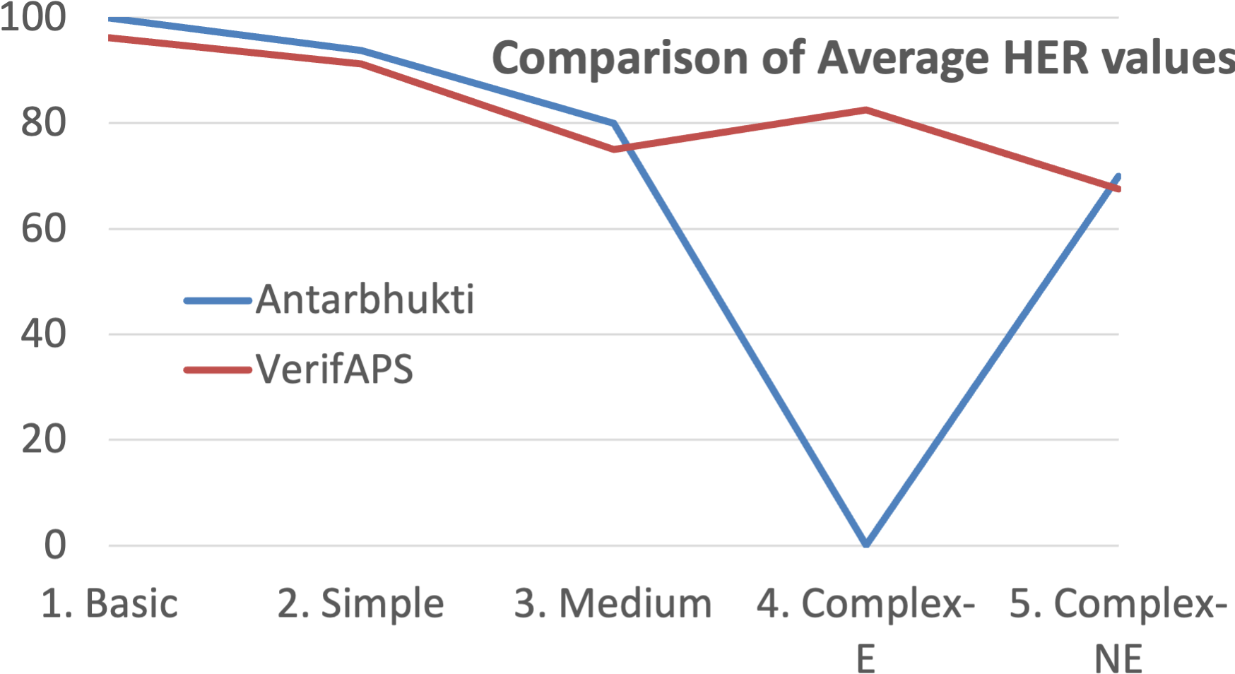
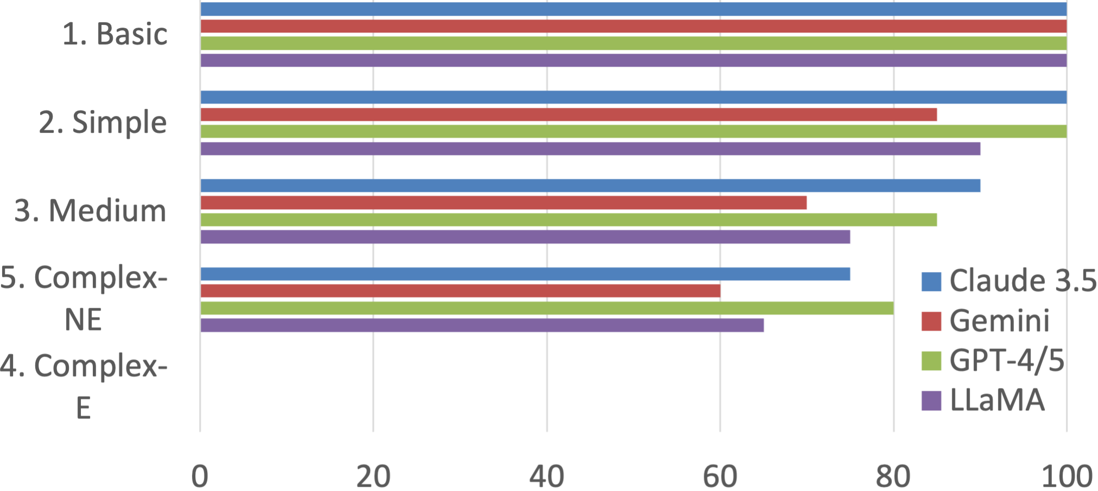
Experimental results

Slide 12
Limitations and Future Work
Cannot handle hierarchical SFC
Fails on functionally equivalent but non-bisimilar code
No support for TON timing blocks
Notes:
There are three major ongoing extensions we are currently exploring:
1. Hierarchical Containment: Extending containment semantics to nested SFC structures using compositional Petri net encoding. 2. Timed Containment: Incorporating timed tokens and clock constraints, allowing us to reason about TON/TOFbehaviors faithfully. 3. Semantic Equivalence Loosening: Detecting when two different upgrade paths are functionally identical under delay or reordering, even if they fail direct bisimulation.
We believe these are natural next steps.

Slide 13
Demo --LLMA

Slide 14

Thank You

